Slide 1
Digital Systems
18B11EC213
Flip-flop conversions

Slide 2
Contents
Excitation tables of
  S-R Flip-flop
  D Flip-flop
  J-K Flip-flop
  T Flip-flop
Flip-flops conversion

Slide 3
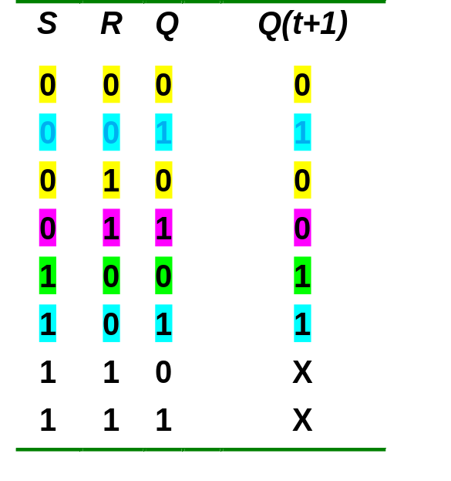
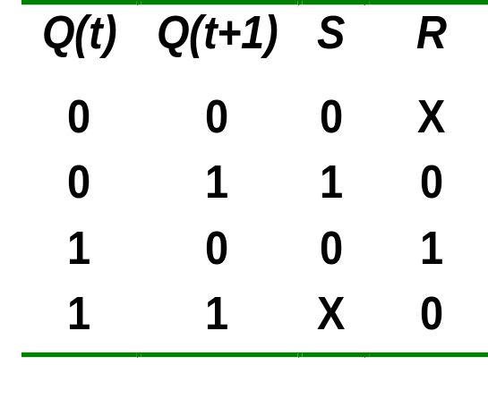
Excitation Table of S-R Flip-flop
Characteristic table
Excitation table

Slide 4
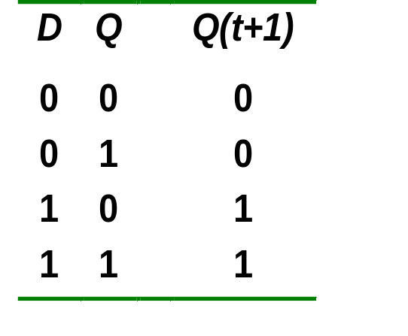
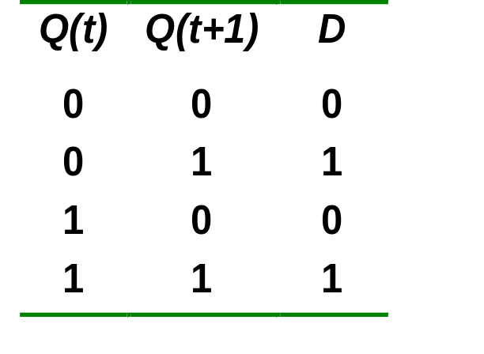
Excitation Table of D Flip-flop
Characteristic table
Excitation table

Slide 5
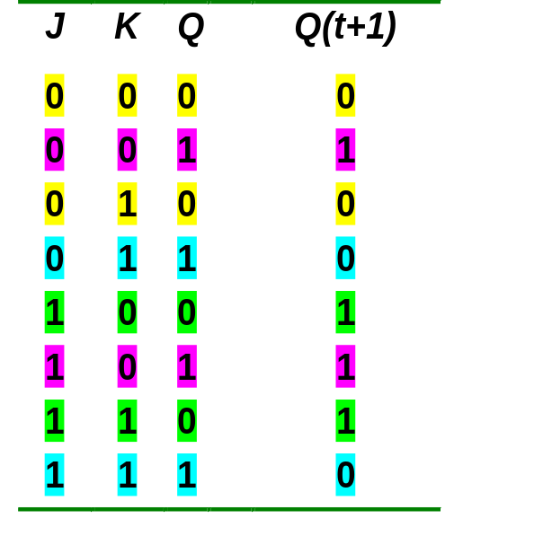
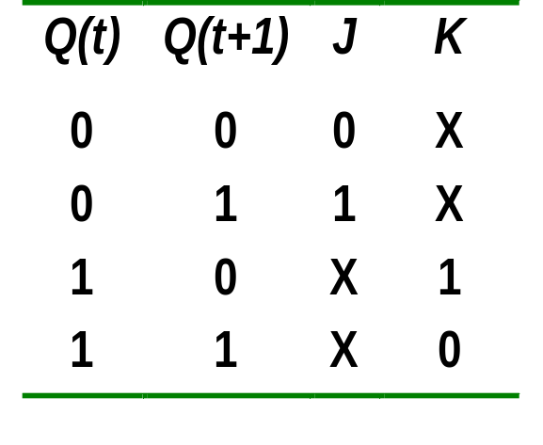
Excitation Table of J-K Flip-flop
Characteristic table
Excitation table

Slide 6
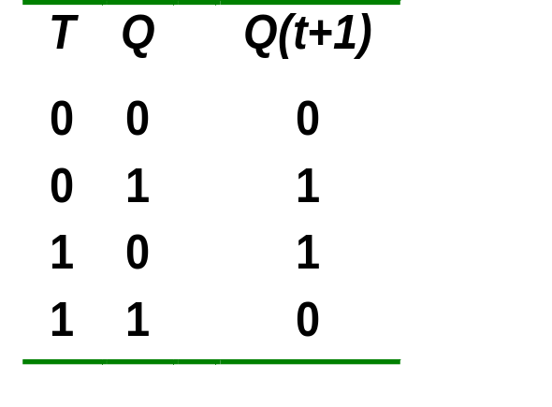
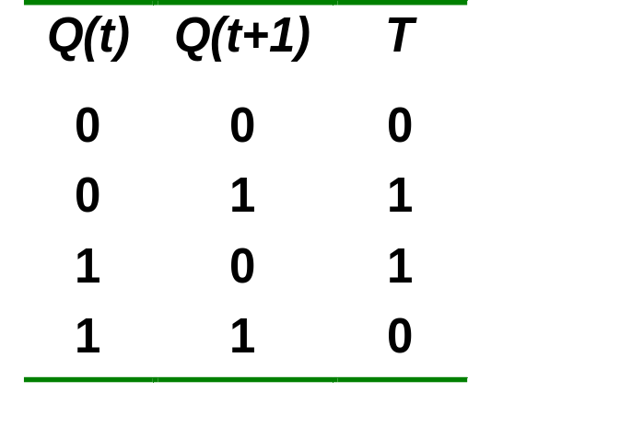
Excitation Table of T Flip-flop
Characteristic table
Excitation table

Slide 7
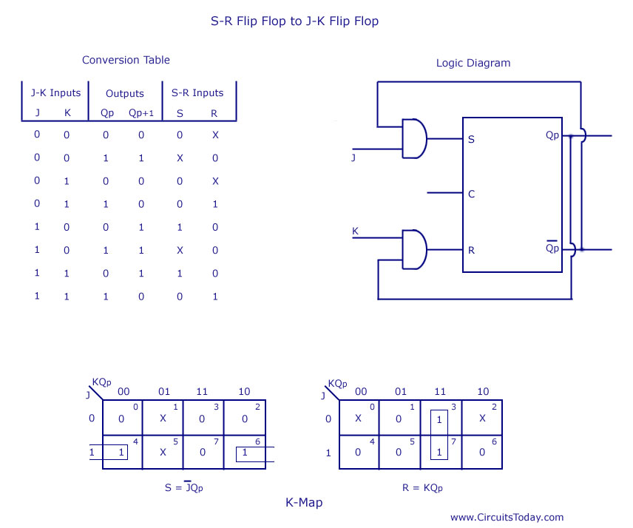
S = JQ_{P}’
CS1103

Slide 8
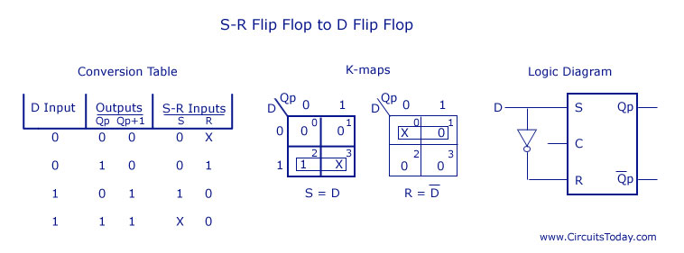

Slide 9
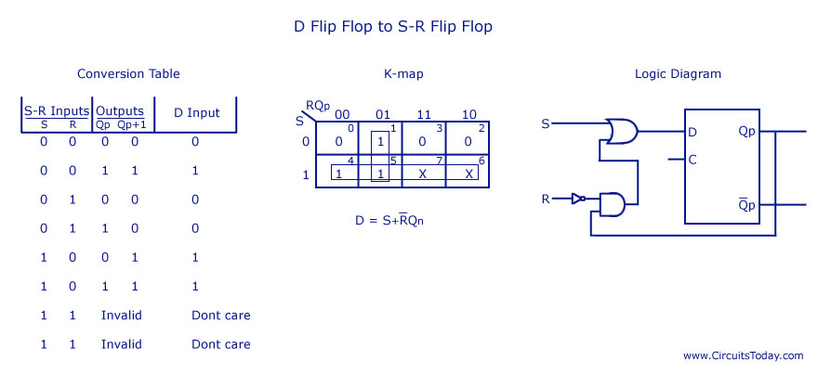

Slide 10
References
A. Anand Kumar, “Fundamentals of Digital Circuits”, PHI, Fourth Edition.
S. Salivahanan and S. Arivazhagan, “Digital circuits and design”, Vikas Publishing House PVT Limited, Fifth edition.

